Slide 1
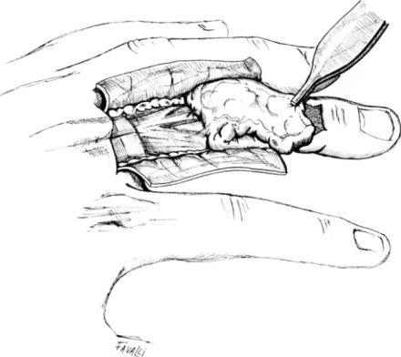
ANATOMIC BASIC OF DORSAL FINGER SKIN COVER
Read magazine:
Jefferson Braga-Silva, MD, PhD
Division of Hand Surgery and Microsurgery, BRAZIL
Vo Hoa Khanh
Department of Reconstructive Microsurgery
Hospital for Trauma - Orthopaedics
Ho Chi Minh City, Vietnam

Slide 2
GOAL
Found the more convenient flaps for coverage of soft tissue defects at dorsal aspect of the fingers

Slide 3
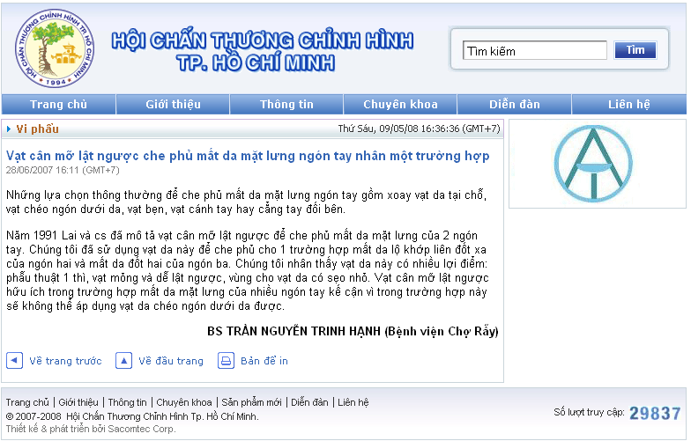
First of all

Slide 4
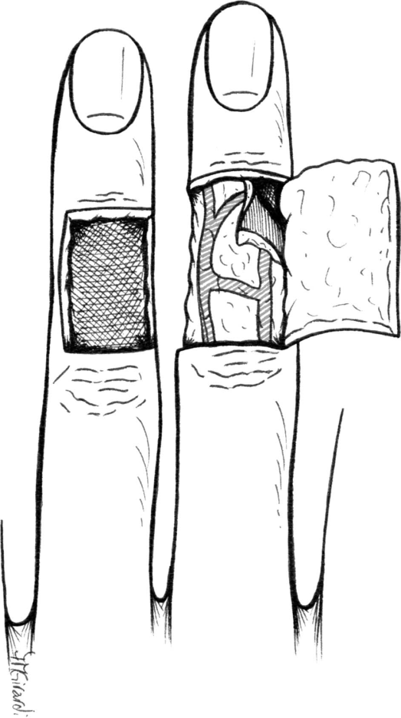
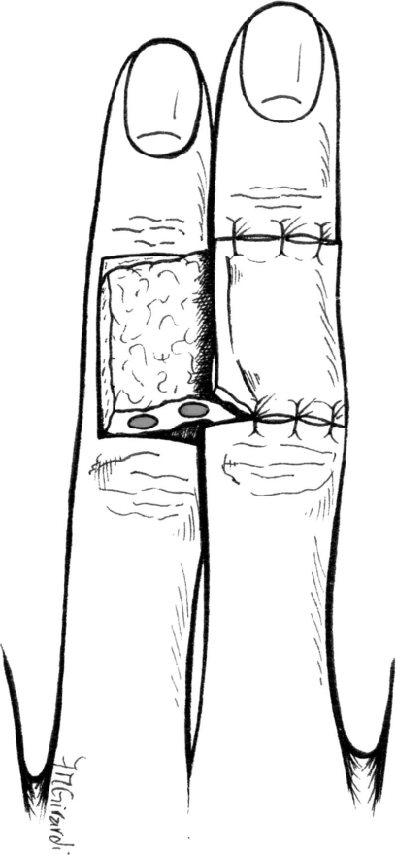
We knew
Early mobilization is made impossible
Need separation of the digits.
Heterodigital Dorsal AdipoFascial Flap
= Reverse Cross Finger

Slide 5
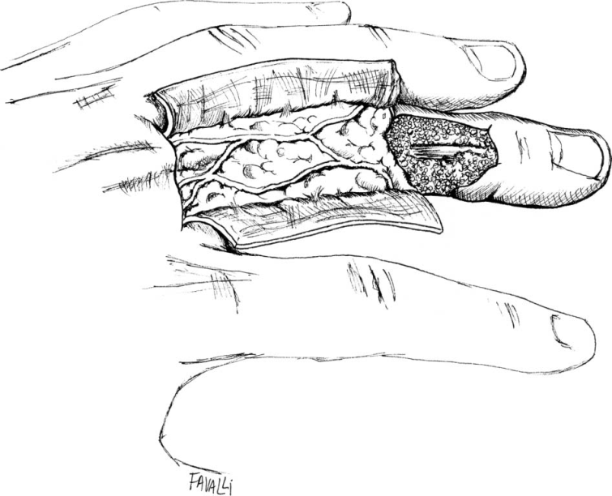
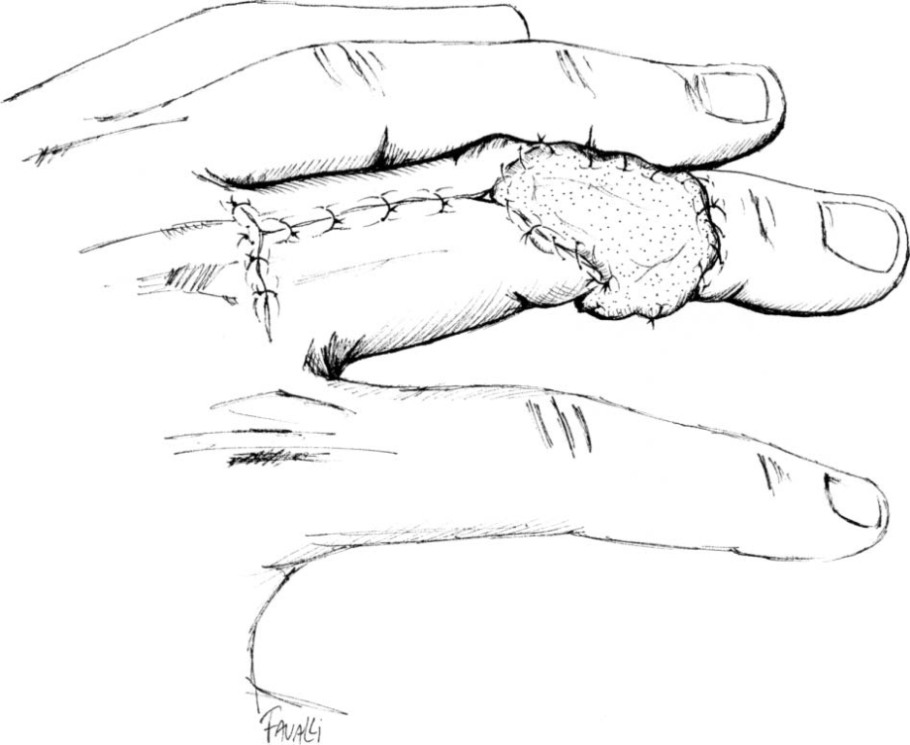
New flap
Homodigital Dorsal AdipoFascial Turnover Flap

Slide 6
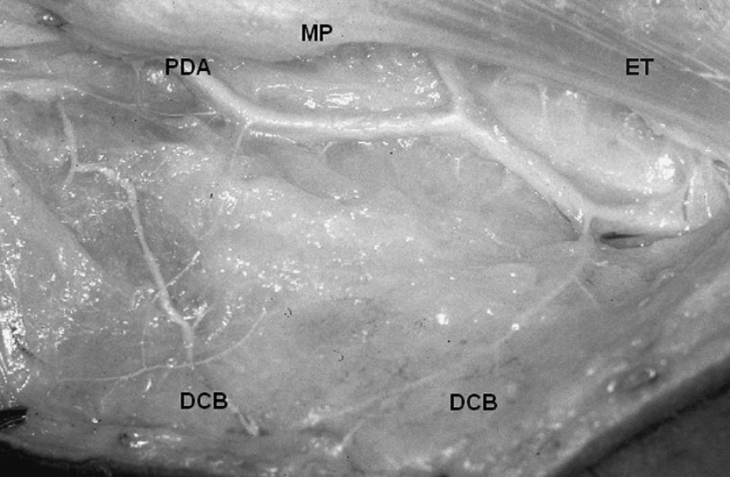
HOW IT COULD BE !
Anatomic data
180 digits were dissected
Injected 35ml of colored latex ( Neoprene ) from humeral artery
Dissections, observation and measure were carried out with the aid of loup manification ( confident intervals is 95% ) to search Dorsal finger Cutaneous Branches
DCB: Dorsal Cutaneous Branch
PDA: Palmar Digital Artery
PIP : Proximal InterPhalangeal joint
MP : MetecarpoPhalangeal joint

Slide 7
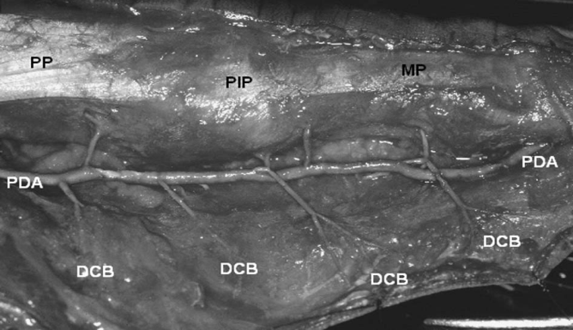
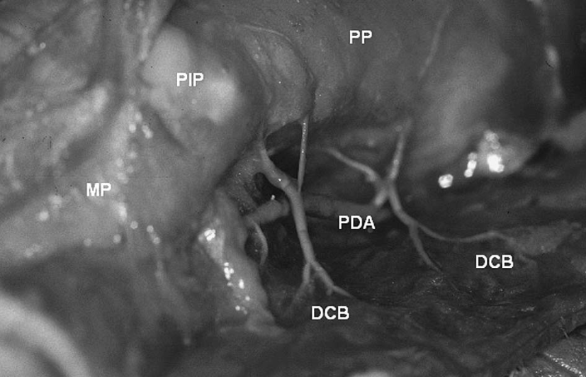
ANATOMIC DATA
There are 1 branch arised from every PDA
There was no statistical difference between the positions of origin of the radial dorsal branches and their corresponding ulnar branches
Branchs are relatively consistent and symmetrical.
In all cases, these dorsal branches anastomose with each other at the level of the joint line.

Slide 8
CLINICAL APPLICATION
56 cases from March 1999 to January 2004
All of them for loss of the cutaneous coverage on the finger dorsum of the proximal, middle or distal phalanx
The age range was 5 – 60 years
The main mechanisms of injury were burn ( 55% ) and crushing ( 40% )
Crushing about 40% for long fingers and 64.3% for thumb

Slide 9
Clinical results of 56 cases
All flaps are survived completely
The flap was carefully incised down to the dermal layer in an H shape
Can cover proximal, middle, distal phalanx
We did not observe any remarkable tendon adhesion in our series
In case of severe crush or degloving injuries , please carefully evaluated
One step surgery

Slide 10
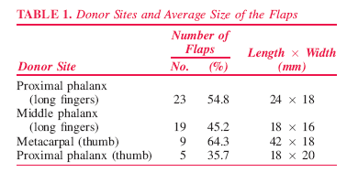
Clinical data

Slide 11
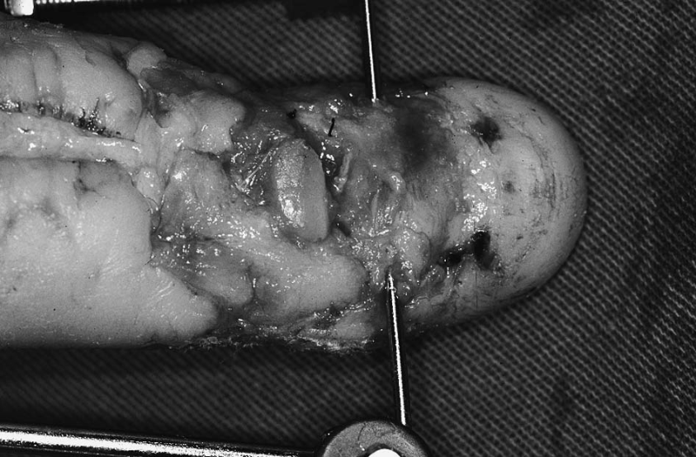
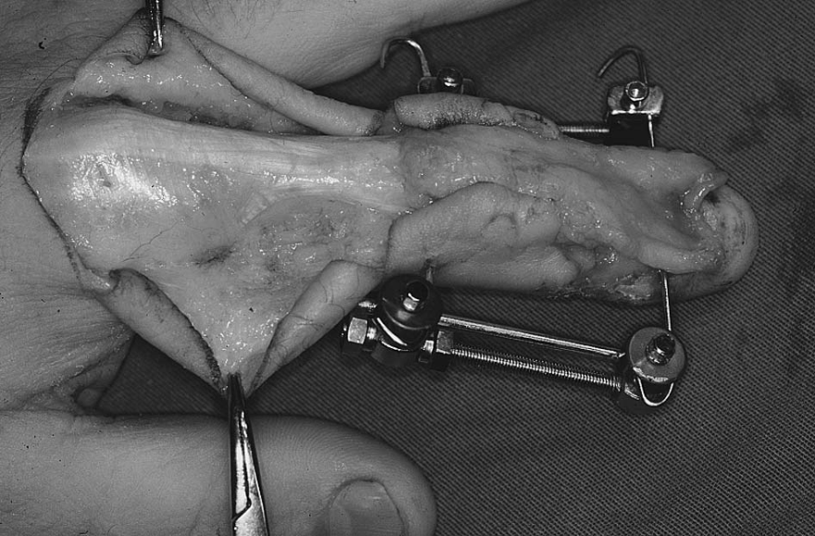
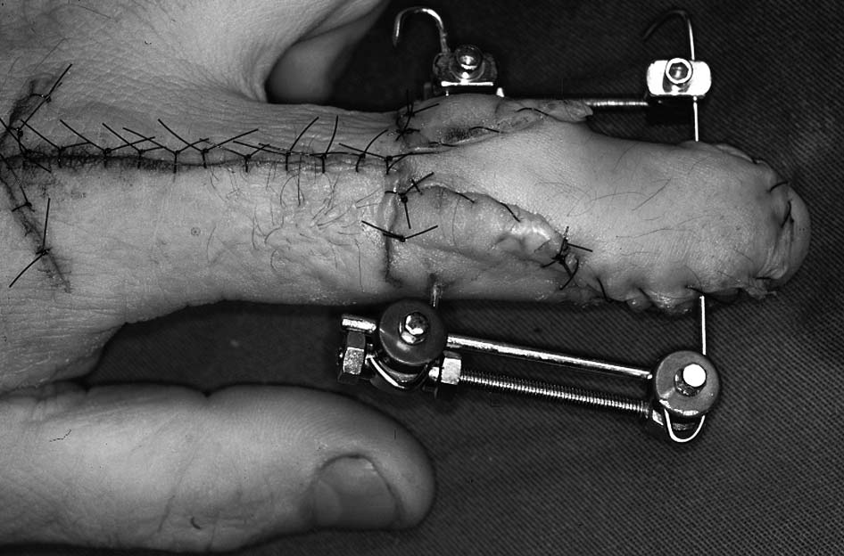
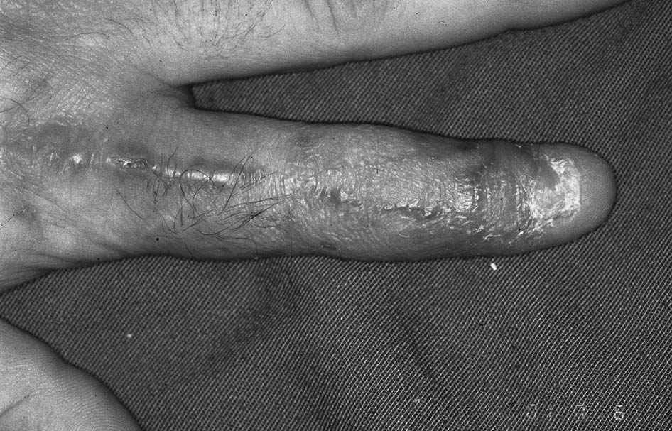

Slide 12
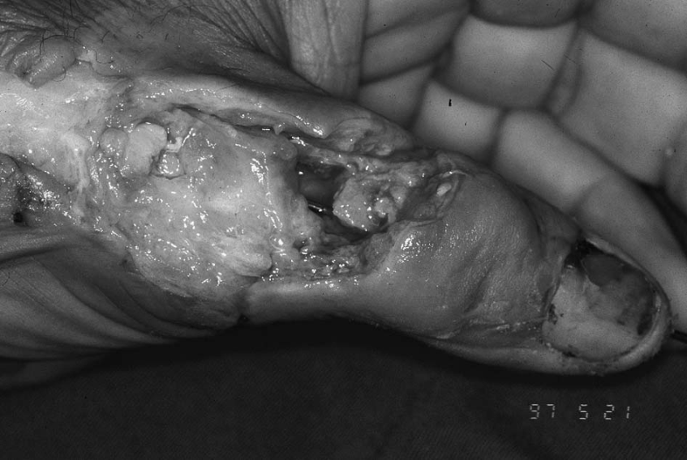
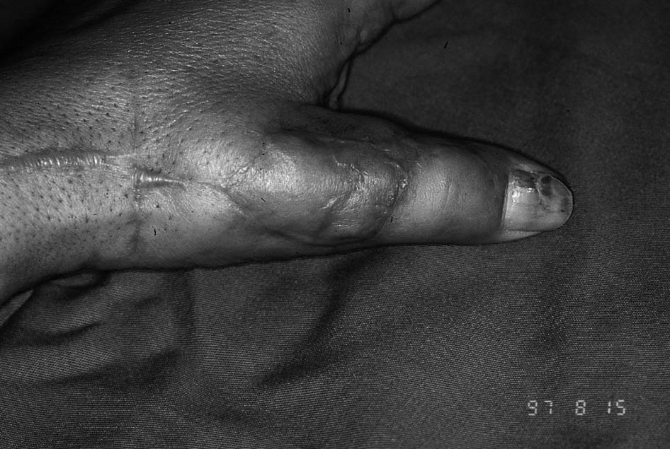

Slide 13
CONCLUSION
The Adipofascial turnover flap has appeared as an excellent alternative to achieve early coverage of cutaneous woulds at the dorsal aspect of the fingers, with one - step operation, reliable flap.
In case of severe crush or degloving injuries, use of this flap must be carefully evaluated.

Slide 14
Thank you
SHARE TO BE SHARED

